Slide 1

Ovis Equipments Private Limited: ISO 9001 certified since 2006

Slide 2
Index
Company Profile
  Introduction
  Vision and Mission
  History
  Achievements
  Processes and Operations
  Today and Tomorrow
Customers
  Industries Served
  Sample Customers
Products
  Shunting Locomotives
  Battery Locomotives
  Transfer Cars
  Special Purpose Railway Wagons
  Wagon/Locomotive Traversors
  High Speed Track Inspection Cars
  Amusement Park Joy Trains
  Railbuses
  Custom Built Equipment
Contact Us

Slide 3
COMPANY PROFILE

Slide 4
Introduction
Incorporated over 25 years ago, the founders of OEPL aspired to create a company that would be at the forefront of rail based products and services in India.
Their innovative approach to do so was to work collaboratively with customers to meet their specific needs to push themselves to provide the most reliable, effective, and original solutions possible.
This commitment to quality and their community has allowed for many achievements, including:
  Being the only ISO 9001 certified private rail company in India
  Having an international presence
  Numerous ‘First in India’ accomplishments (highlighted later)

Slide 5
Vision and Mission
Vision
  To be a market leader in the design & manufacture of rail based material handling systems and customised equipments through appropriate technology
Mission
  To achieve this vision, our mission is to perform as ‘manufacturers of equipments on sound & optimum design platform based on customers’ needs and quality expectation ensuring promised delivery and performance leading to permanent customer delight.’

Slide 6
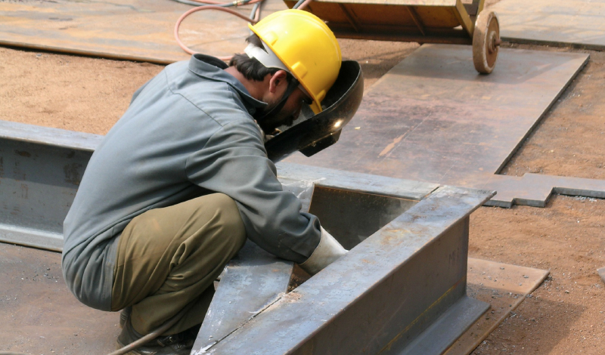
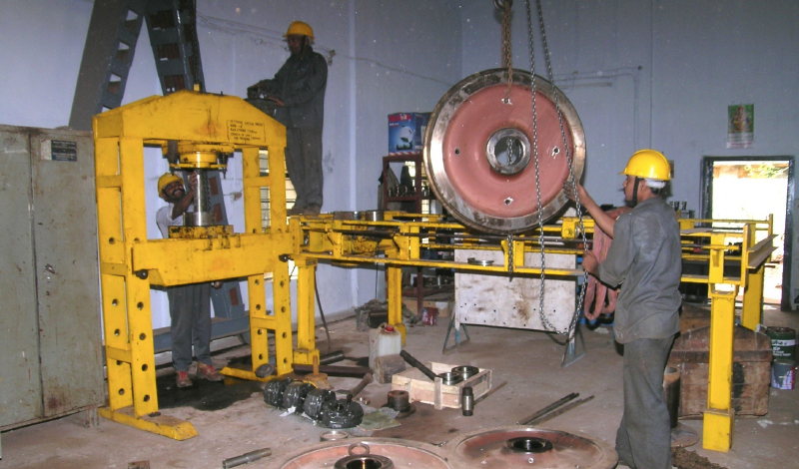
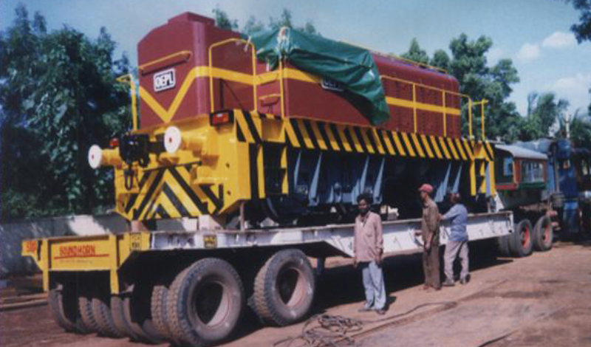
History
Incorporated in 1987 by a team of technocrats in Hyderabad, India.
  Founders: Mr. UJ Dhanapaul, Mr. R Muralidharan, and Mr. MSR Chari
  Other current executives: Mr. D Arun Prakash, Mr. K Suresh Chary, Mr. KK Mahadevan, and Mr. K JayaKKumar
Registered as a small scale industry with the Dept. of Industries: Govt. of AP and National Small Industries Corporation: Govt. of India.

Slide 7
Achievements
  First in India to manufacture closed loop twin power pack (2X335hp) 90 tonne hydrostatic locomotive
  First in India to manufacture diesel hydraulic air-conditioned rail bus in the private sector
  First in India to export MG track maintenance vehicle
  First in India to export track panel (18m long) laying equipment.
  First in India to manufacture hydraulic locomotive for in-motion wagon loading
  First in India to manufacture 350 tonne turntable
  BG track maintenance vehicle with RDSO approval
  Battery locomotive with MOSFET based motor controller
  40 tonne capacity rail borne transfer car with diesel hydrostatic drive
  350 tonne capacity diesel powered rail borne transfer wagon
Notes:
Achievements – make 2 slides with more images?

Slide 8
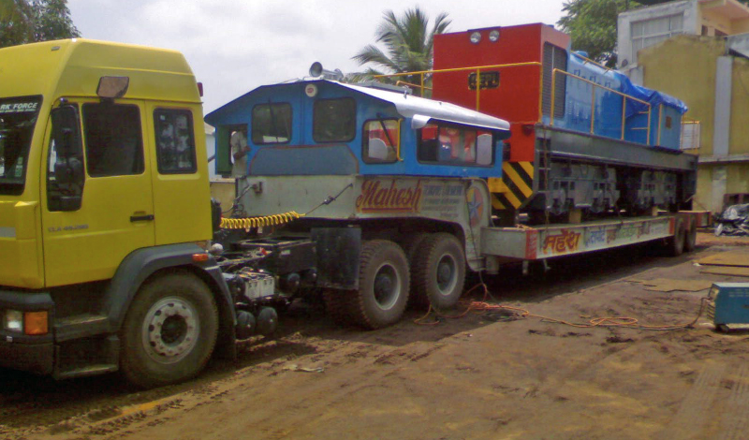
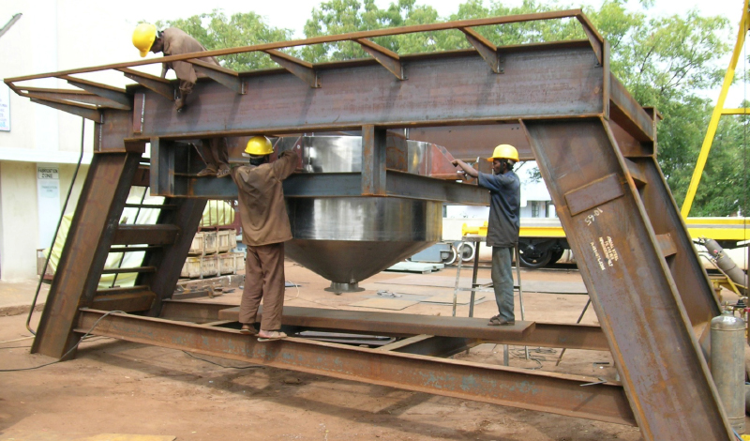
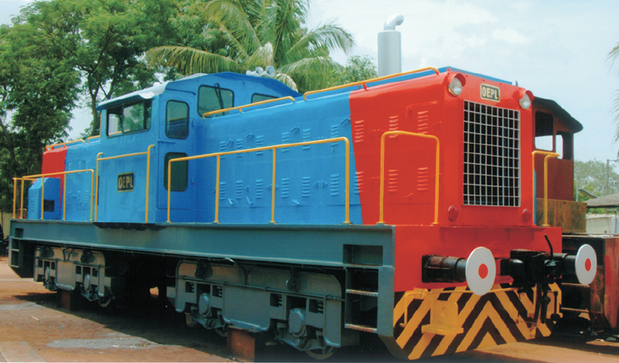
Processes and Operations
The strengths of our team of engineers and designers:
  Have developed powerful in-house software for the optimal design of many critical components
  Built an in-house drafting and modeling facilities
  Meet national and international standard national and international standards set by ISO in Quality Management System

Slide 9
Today and Tomorrow
Looking Forward…
  OEPL’s reach extends nationally and internationally (customers range across Asia and Africa)
  Each of the four founders retain key executive roles with OEPL, leading new engineers and designers in developing the next generation of rail-based solutions
  Exemplary after-sales support is a prime focus
  Employing a ‘best of breed’ approach to operations, suppliers must meet stringent quality controls; suppliers originate primarily from India and Germany
  OEPL has added a second production facility to meet demand, meeting ISO quality standards and developed in-house design software to compliment industry standards

Slide 10
CUSTOMERS

Slide 11
Industries Served
OEPL products have applications in major facilities in a range of industries. Across India and internationally, our products can be found in the following business sectors:
  Cement
  Steel
  Mining and tunneling
  Power plants
  Shipyards and ports
  Railways and related
  Defence
  Heavy industries
  Other organizations
Due to our collaborative approach of working with customers and our drive to innovate, the possibilities for applications extend beyond these industries.

Slide 12
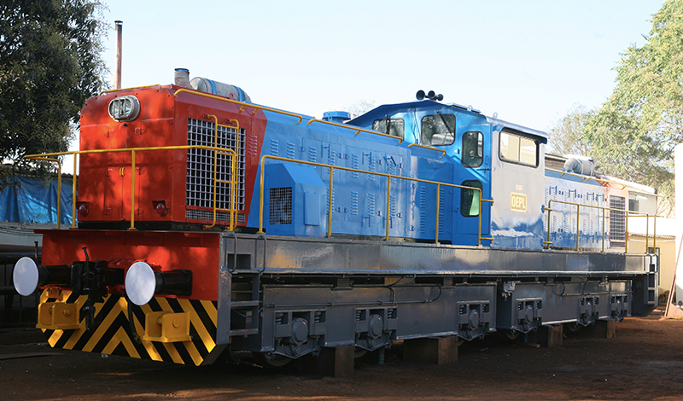
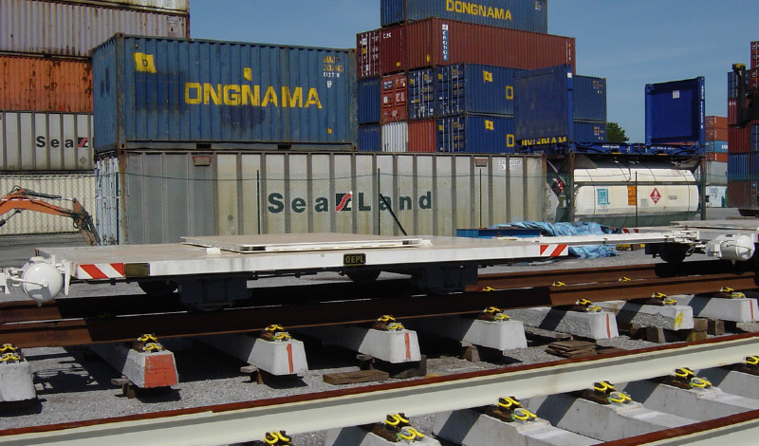
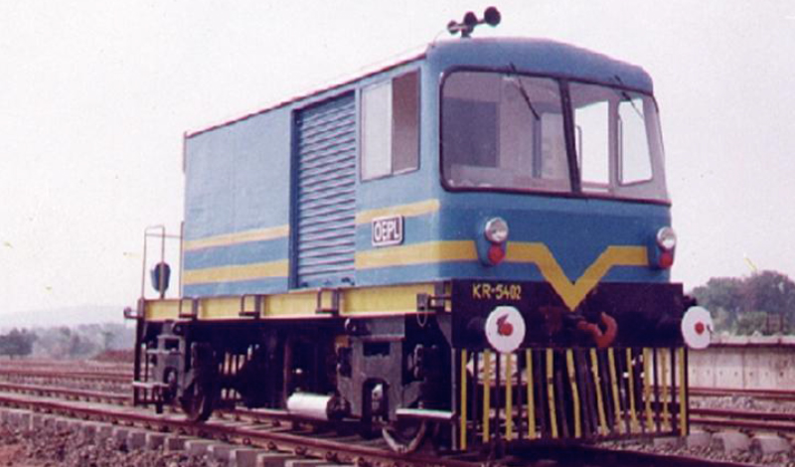
Sample Customers
Ultratech Cement Ltd.
  1200 hp 135 tonne Diesel Hydraulic Locomotive
M/s Preshcon, Singapore
  18m Rail Panel Transfer Trolley
M/s Konkan Railway Corporation Ltd.
  High Speed Track Inspection/ Maintenance Vehicle

Slide 13
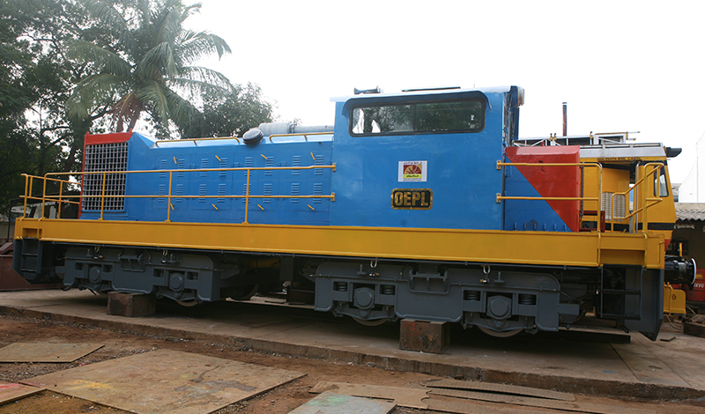
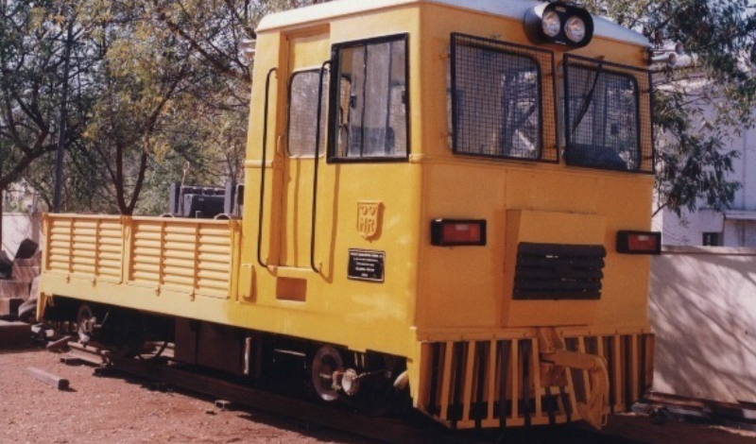
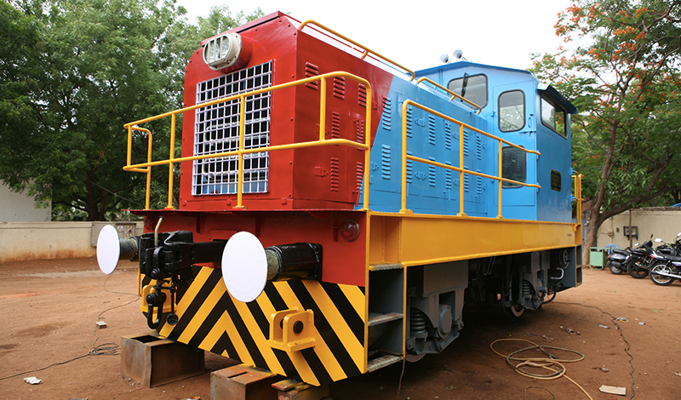
Sample Customers
Ultratech Cement Ltd.
  800 hp 90 tonne Diesel Hydraulic Locomotive
Myanmar Railways, Burma
  Rail Gang Car
Tube Products of India
  400 hp 45 tonne Diesel Hydrostatic Locomotive

Slide 14
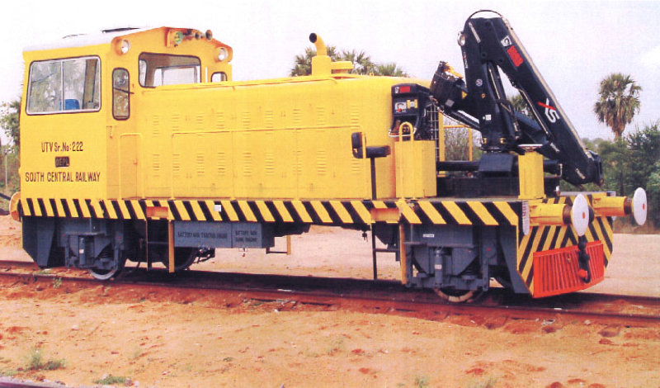
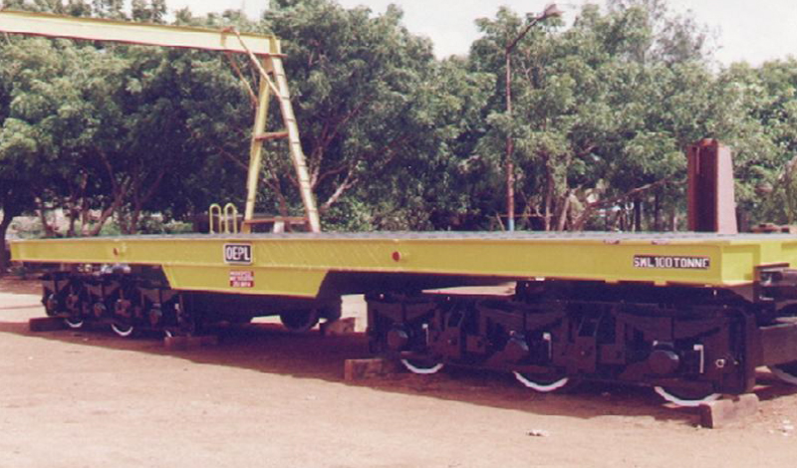
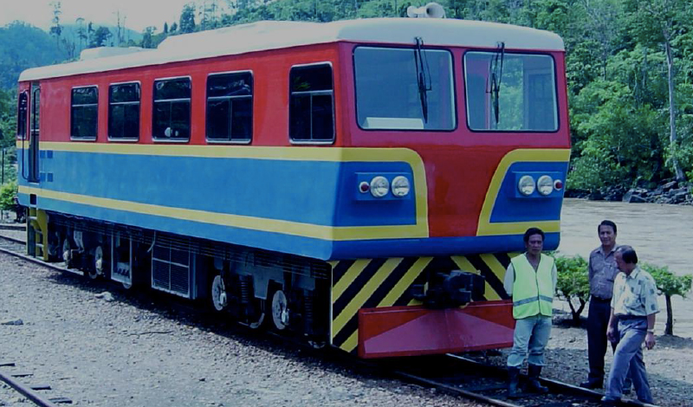
Sample Customers
Indian Railways
  BG Utility Vehicle
M/s Bharat Heavy Electricals Ltd.
  100-120 tonne 6 Axle Flat Wagon
Sabah Railways, Malaysia
  MG Rail Bus

Slide 15
PRODUCTS

Slide 16
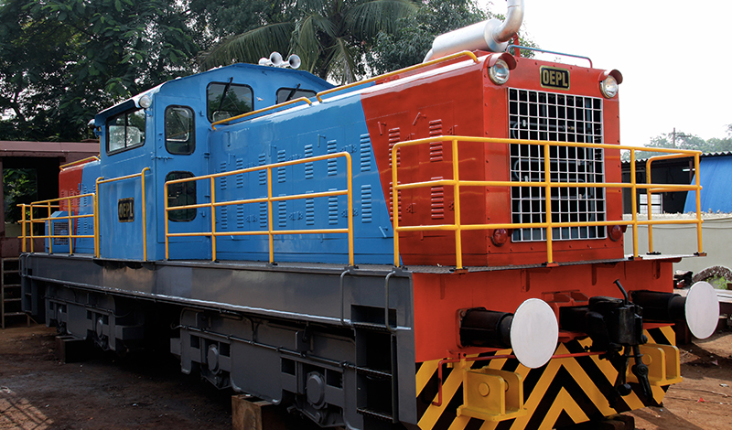
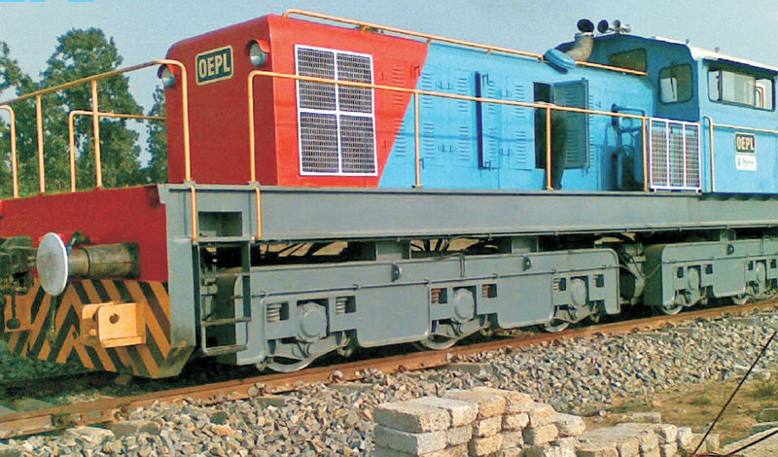
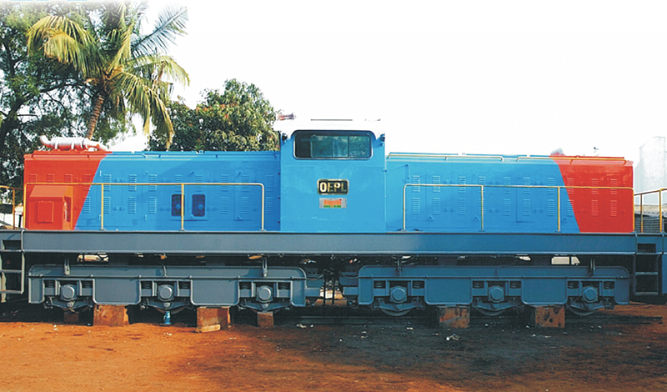
Shunting Locomotives
Track Gauge
  Narrow (610 & 762 mm)
  Meter (1000 & 1067 mm)
  Standard (1435 mm)
  Broad (1676 mm)
Types
  Diesel Mechanical
  Diesel Hydraulic
    Hydrostatic & Hydrodynamic
  Diesel Electric
  Flame Proof Locomotives
Capacities
  50 – 1200 hp (Installed Power)
  45 – 135 tonne (Adhesive Weight)

Slide 17
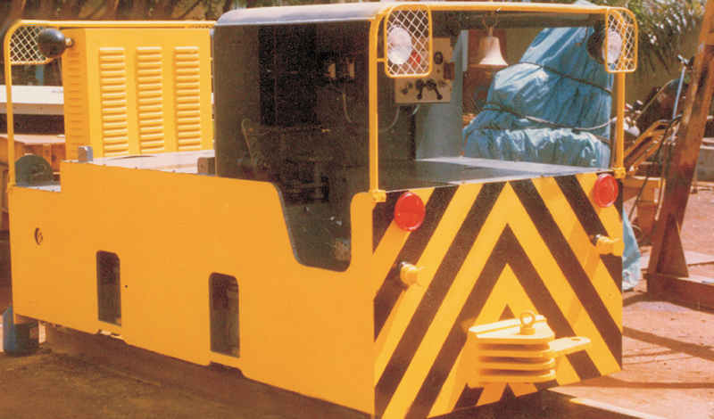
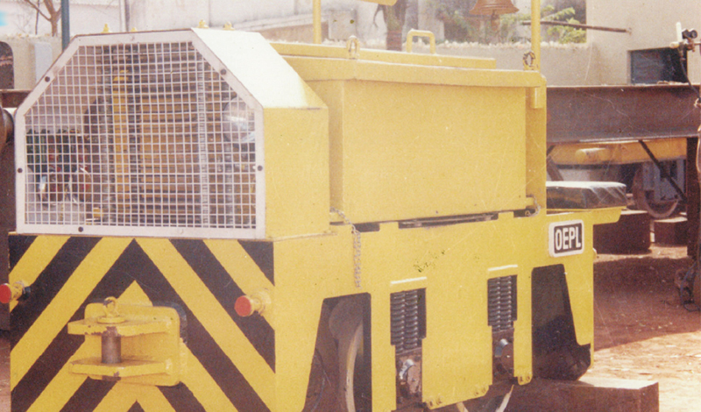
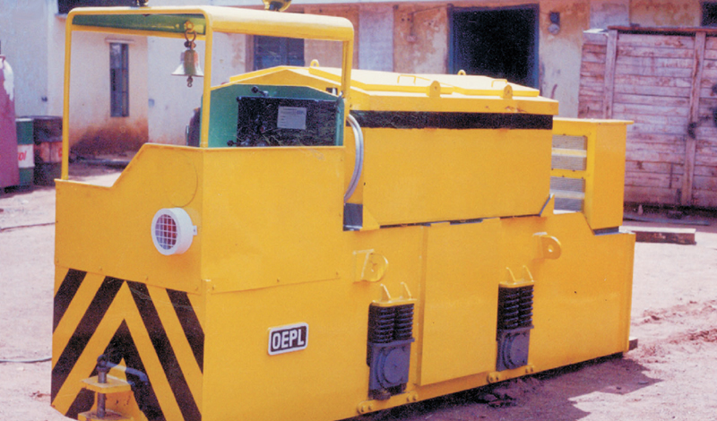
Battery Locomotives
Track Gauge
  Narrow (610 & 762 mm)
  Meter (1000 & 1067 mm)
Capacity
  2 – 30 tonne (Adhesive Weight)
Motor Speed Variation
  Resistance Control
  MOSFET Control

Slide 18
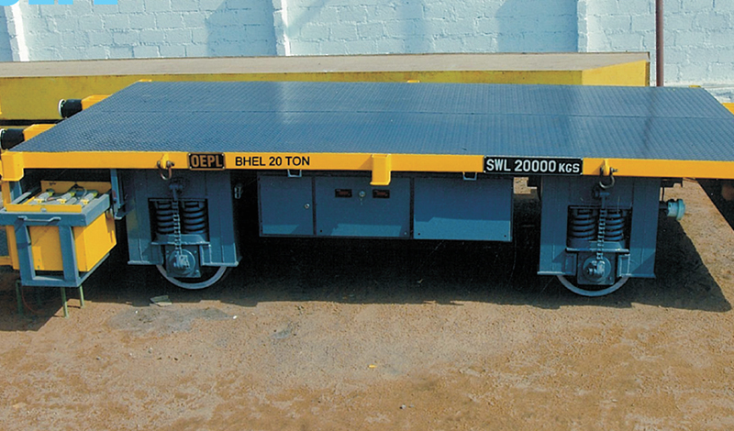
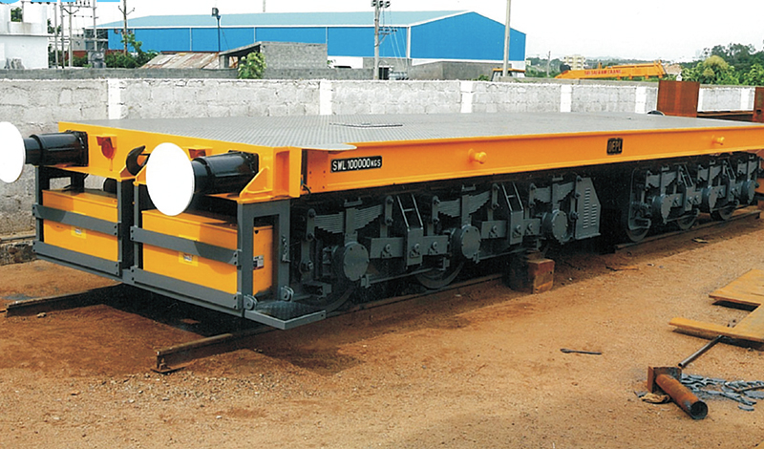
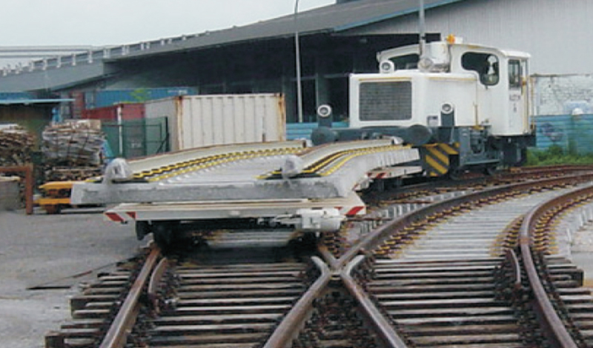
Transfer Cars
Track Gauge
  Narrow (610 & 762 mm)
  Meter (1000 & 1067 mm)
  Broad (1676 mm)
Capacity
  5 – 350 tonne (Carrying Capacity)
Power
  AC/DC
  Diesel Operated

Slide 19
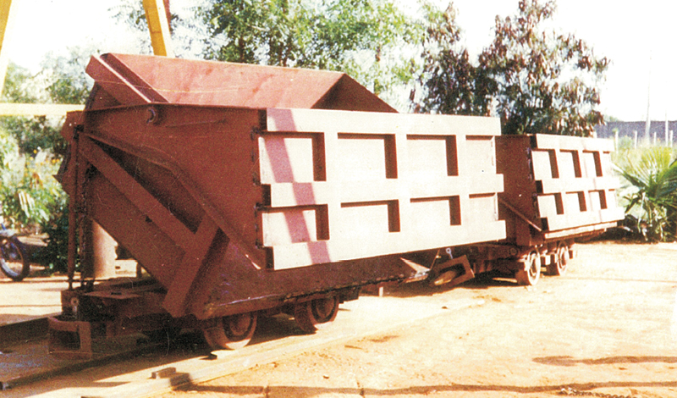
Special Purpose Railway Wagons
Track Gauge
  Narrow (610 & 762 mm)
  Meter (1000 & 1067 mm)
Capacity
  2.5 – 8 tonne (Carrying Capacity)

Slide 20
Wagon/Locomotive Traversors
Track Gauge
  Narrow (610 & 762 mm)
  Meter (1000 & 1067 mm)
  Broad (1676 mm)
Capacity
  40 – 250 tonne (Carrying Capacity)

Slide 21
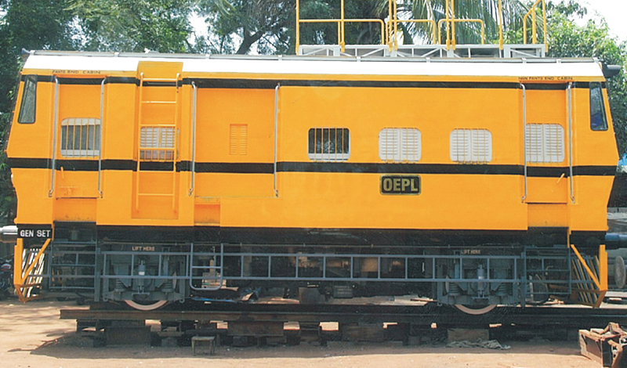
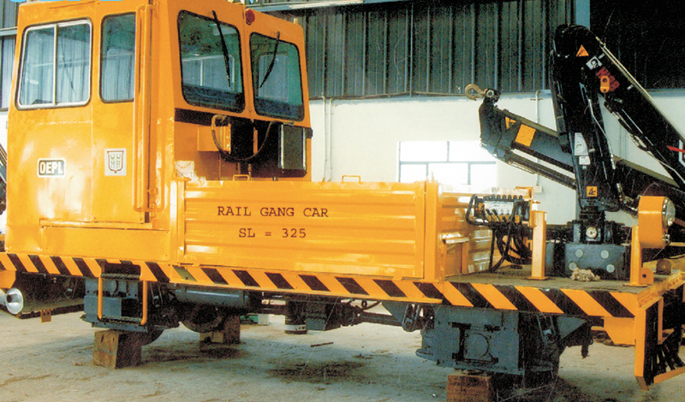
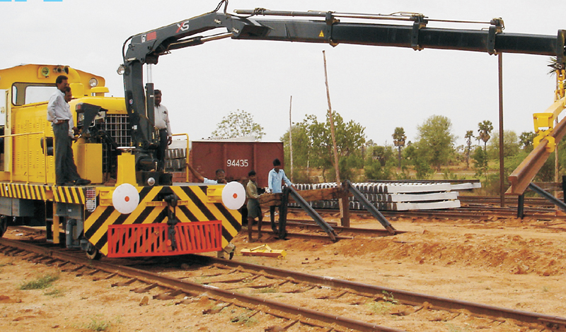
High Speed Track Inspection Cars
Track Gauge
  Meter (1000 & 1067 mm)
  Standard (1435 mm)
  Broad (1676 mm)
Speed
  Up to 70 kmph

Slide 22
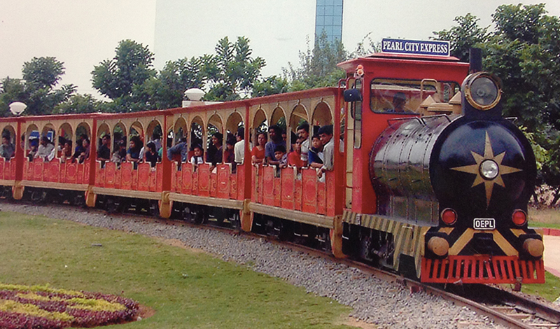
Amusement Park Joy Trains
Variable as per customer specifications

Slide 23
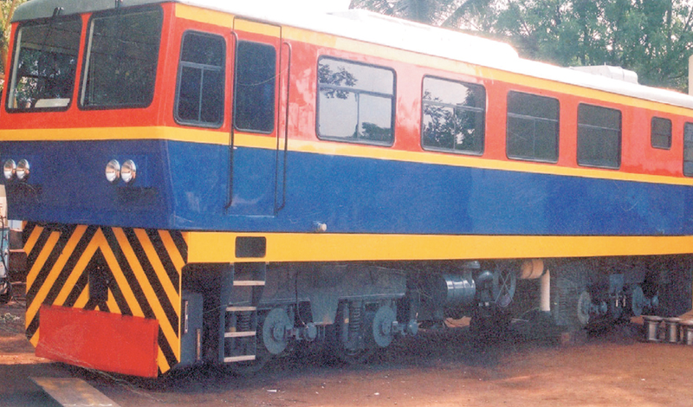
Railbuses
Track Gauge
  Meter (1000 & 1067 mm)
  Standard (1435 mm)
  Broad (1676 mm)

Slide 24
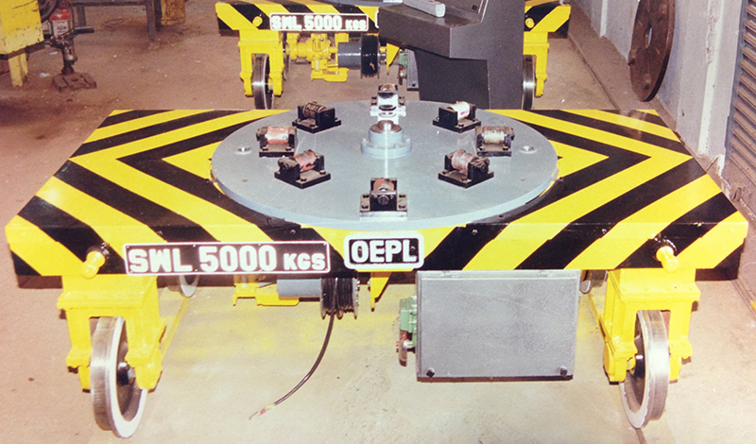
Custom Built Equipment
Variable as per customer specifications

Slide 25
CONTACT US

Slide 26
Contact Us
We would be happy to answer any queries you might have. Please contact us by any of the means below.
Email
  ovisequipments@gmail.com
Mailing
  Shed No: 43
  IDA Phase II
  Cherlapally
  Hyderabad, 500 051
  India
Telephone
  +91 40 27263461
  +91 40 27260933
  +91 40 27263482
Fax
  +91 40 27263462
Visit us online at: www.OEPL.in

